Slide 1
The Fundamentals of Data Visualization, Data Modeling and Dashboard Design
Created By: Jeffery A. Shaffer Vice President, Unifund Adjunct Faculty, University of Cincinnati (513) 615-0001 | JeffreyShaffer@gmail.com @HighVizAbility
Notes:
Title Slide

Slide 2
Goals
By completing the course modules, students will:
Learn data visualization best practices by compare and contrast through numerous examples
Learn how design choices can distort the data or hide it completely
Discuss complexity and simplicity in data visualization

Slide 3


Slide 4
Compare and Contrast
Notes:
NOTE:
The purpose of this section is to demonstrate data visualization through compare and contrast examples. We will show various examples.
Example 1 – wrong chart type in 3D and poor use of color contrasted with a simple scatter plot which shows the data better. Also include an innovative scatter plot using images.
Example 2 – A bar chart that works for the data, but simply needs to be rotated to make it easier to read the text (same chart type and design, but just needs to be rotated)
Example 3 and 4 – 3D bar chart and 3D pie charts that are not effective
Example 5 - A series of charts that have numerous issues using Google data.
Fox News Unemployment Rate Chart – a line chart that has a data issue
SAS Revenue Growth– a poorly designed chart by SAS followed by a redesign that SAS created and republished.
Napoleon's March by Charles Minard – A class discussion around a very famous chart. Is it the “best statistical graph ever done”?

Slide 5
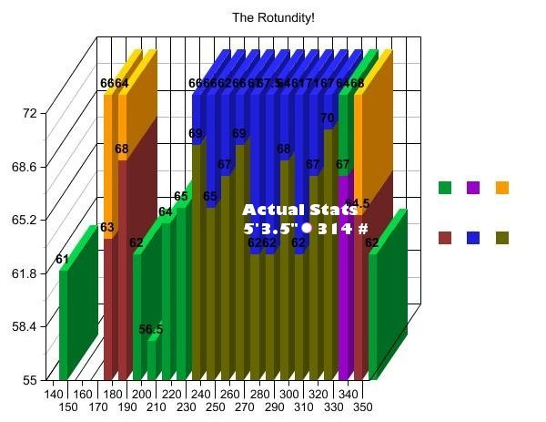
Source: “Rotundity Revealed” by Kate Harding
http://www.shakesville.com/2007/09/rotundity-revealed.html
Notes:
This chart was created to visualize the guesses of someone’s height and weight from a picture. The picture was posted on-line and readers of this blog guessed the height and weight. The white dot represents the woman’s actual height and weight. Consider how hard this graph is to decipher. Thankful a color legend was included so that we know what the color means. [pause]
Ms. Harding is a trained writer, not someone that was trained in creating data visualization. However, even she was confused on how to read this. She wrote on her blog, “To be honest, I'm not even sure how you're supposed to read this graph, and I'm the one who made it.”

Slide 6
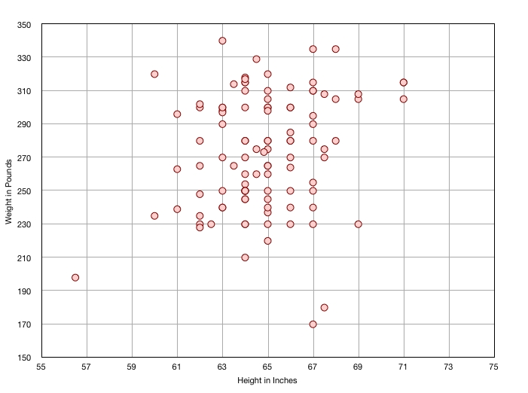
Notes:
For a simple height and weight comparison, we might use a scatter plot. This makes the comparison of the two measures easy to see. Although, height might be better on the y-axis and weight on x-axis.

Slide 7
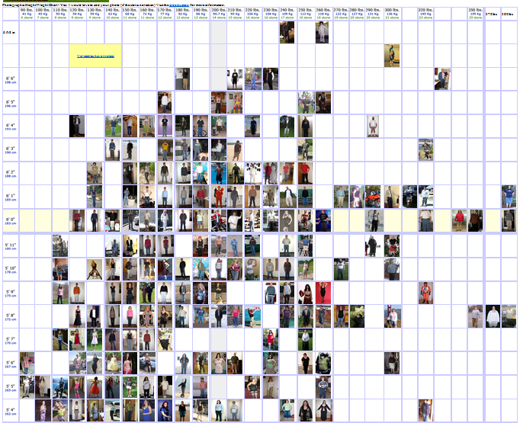
Source: http://www.height-weight-chart.com/heightweight.html
Notes:
This website shows a scatter plot of height and weight, but uses pictures of people instead of dots. Users can upload images of themselves matching various heights and weights. You can click on any height and weight and see what the people look like.

Slide 8
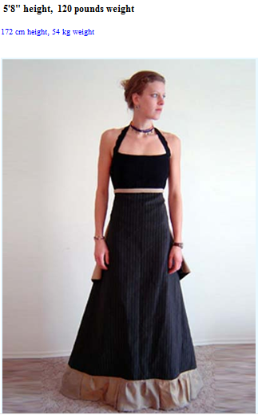
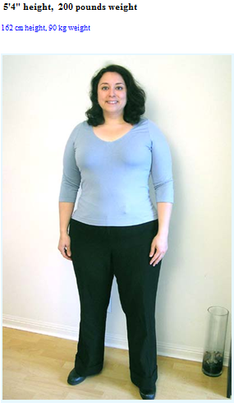
Source: www.cockeyed.com/photos/bodies/heightweight.html
Notes:
You can now make a visual comparison, in this case, someone who is 5 foot 8 inches tall and weighs 120 pounds compared to someone that is 5 foot 4 inches tall and weights 200 pounds. We’ve all seen thousands of people in our lifetime, so we can match those images in our memory to these characteristics.

Slide 9
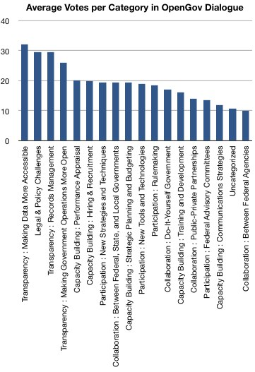
Source: Office of Science and Technology Policy Blog (1/2009)
www.OSTB.gov
Notes:
The previous example was the wrong chart type. But let’s look at an example where the chart type isn’t the problem. We see this one a lot in data visualization. The first thing people do when they see this kind of chart is rotate their head to try to read the labels. This isn’t helpful, especially when there are really long labels.

Slide 10
“The language of bar charts speaks both vertically and horizontally.”
Jeffrey A. Shaffer
Adjunct Professor Data Visualization
University of Cincinnati

Slide 11
Source: Office of Science and Technology Policy Blog (1/2009)
www.OSTB.gov
Notes:
In this case, just rotate the chart. The length of the bars are just as easy to compare, but now the labels are easy to read as well.

Slide 12
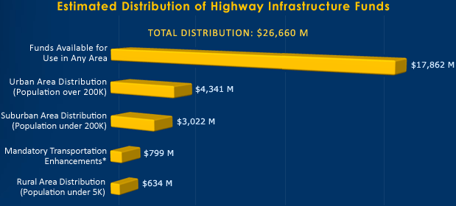
Source: www.Recovery.gov (website has been taken down)
Notes:
This chart was featured on Recovery.org before the website was taken down. I guess they felt the data should come off the page at you. Notice the problems when representing a 3D object in 2D. There is lots of “digital ink” needed to create the 3D effect. This affects the way that we perceive this information and it makes comparisons very difficult and precise comparisons near impossible.

Slide 13
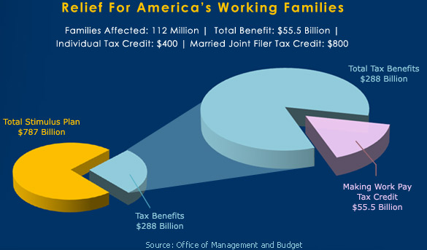
Source: www.Recovery.gov (website has been taken down)
Notes:
This is another example from Recovery.org. If one 3D exploding pie chart isn’t bad enough, we’ll explode it into another 3D exploding pie chart. Notice what the extra “digital ink” does in this case. The slice in the front of the piece chart will have extra ink, making the slices up front much bigger than the poor slice in the back that does not get the extra “digital ink”.

Slide 14
Do you agree?
“Google just released their Q2 ’06 financial results, but most of us get lost in numbers, plus there isn’t really a way to quickly see where these guys are heading. With the help of Create A Graph I compiled these smooth nice looking graphs representing Google’s financial data over the last 3.5 years. This should give some perspective and is much more exiting, clear, and graphic than the flat (and boring) table numbers.”
“I don’t like Excel graphs, I think it’s worth the effort to come up with such pretty graphs…”
http://googled.wordpress.com/2006/07/25/35/
Notes:
This page is no longer online, but you can read the post on The Way Back Machine if you are interested. This person decided to visualize Google financial results in a “much more exciting, clear and graphic” way. Let’s see if you agree.

Slide 15
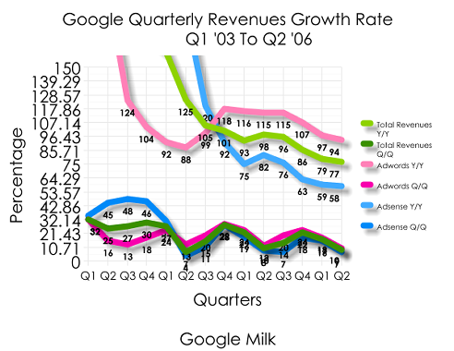
Notes:
Here’s Google’s Quarterly Revenue Growth. We see lots of issues here. Labels are plotted on top of each other, the color choices are great. The quarters are listed on the bottom on the chart without year, so without the subtitle at the top we would have no idea what years are being displayed. The most interesting things about this one is the y-axis. I’ve never seen someone plot a y-axis in such interesting increments. It’s hard to imagine that plotting in increments of 10.7145% would be useful to anyone and then after using such a precise number to then round to two decimal places on the y-axis and no decimal places on the data labels.

Slide 16
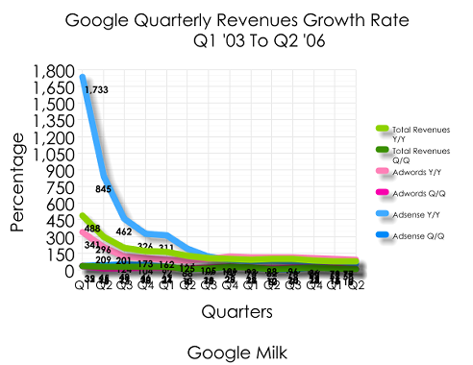
Notes:
This one goes even further with the data labels. They are plotted on top of everything now.

Slide 17
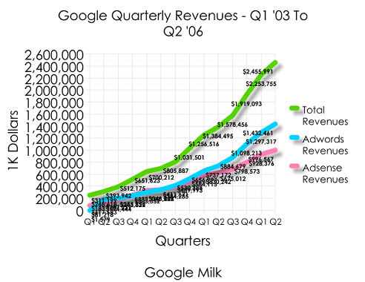
Notes:
And finally this one. Even more data labels making it impossible to read anything. I particularly like the decision to put the y-axis in units of 1k dollars to avoid adding 3 zeros to those numbers. Why not millions or even billions?

Slide 18
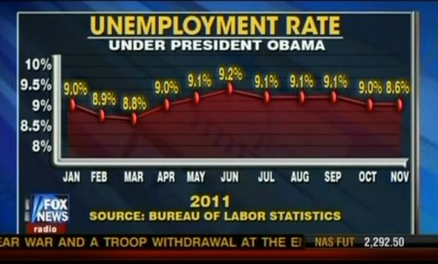
What’s wrong with this chart?
Notes:
Let’s look at this example done by Fox News. What’s wrong with this one?
[the last point of 8.6% is not plotted correctly. It is plotted as 9%]

Slide 19
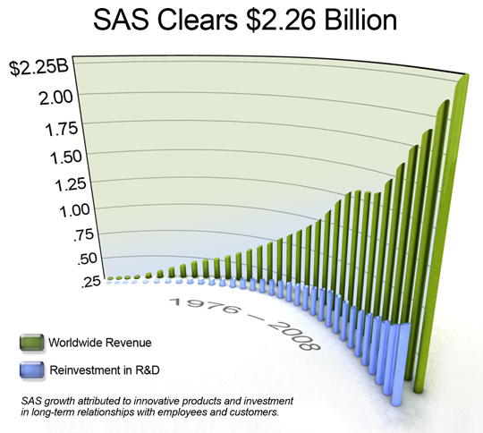
Source: SAS Press Release on February 4, 2009
Notes:
This example comes from SAS and they really should know better. The numbers here come off the page at you making it impossible to interpret this data. The data visualization community jumped on this on. One example is a blog post written by Stephen Few called “Data Visualization and Dog Food”.
Source:
https://www.perceptualedge.com/blog/?p=410

Slide 20
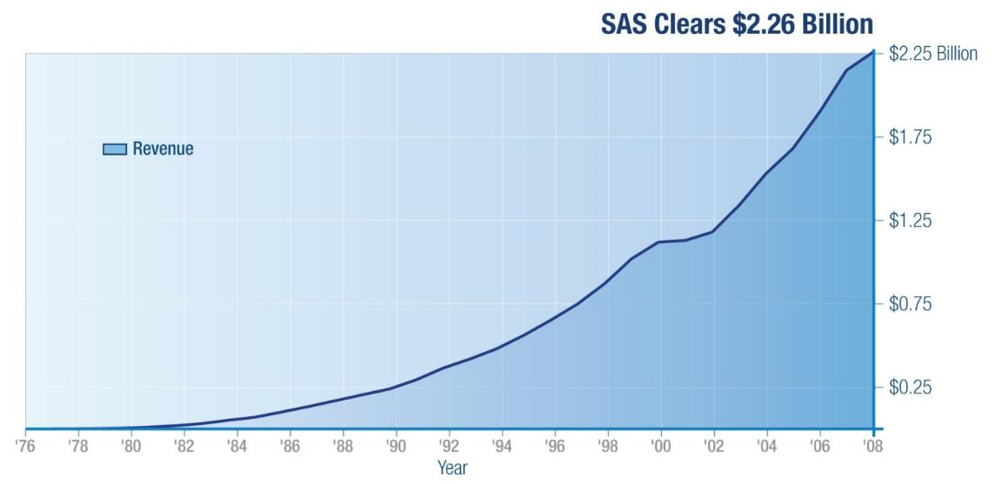
Source: SAS Institute Project Presentation
https://www.slideshare.net/aghussien/sas-institute-project-presentation
Notes:
SAS updated the graph, blaming it on the marketing department. This graph and variations of it were then used in future press releases and presentations.

Slide 21
A Famous Visualization
Notes:
NOTE:
In this section you will use a famous visualization to have a class discussion about the complexity of data visualization. Some in the class may like the visualization, the level of detail it provides and the many different variables. Others may think it’s too complex. This can be compared to the different levels of details that certain users need in an organization. For example a top level summary for an executive vs. a detailed report for an operations person.

Slide 22
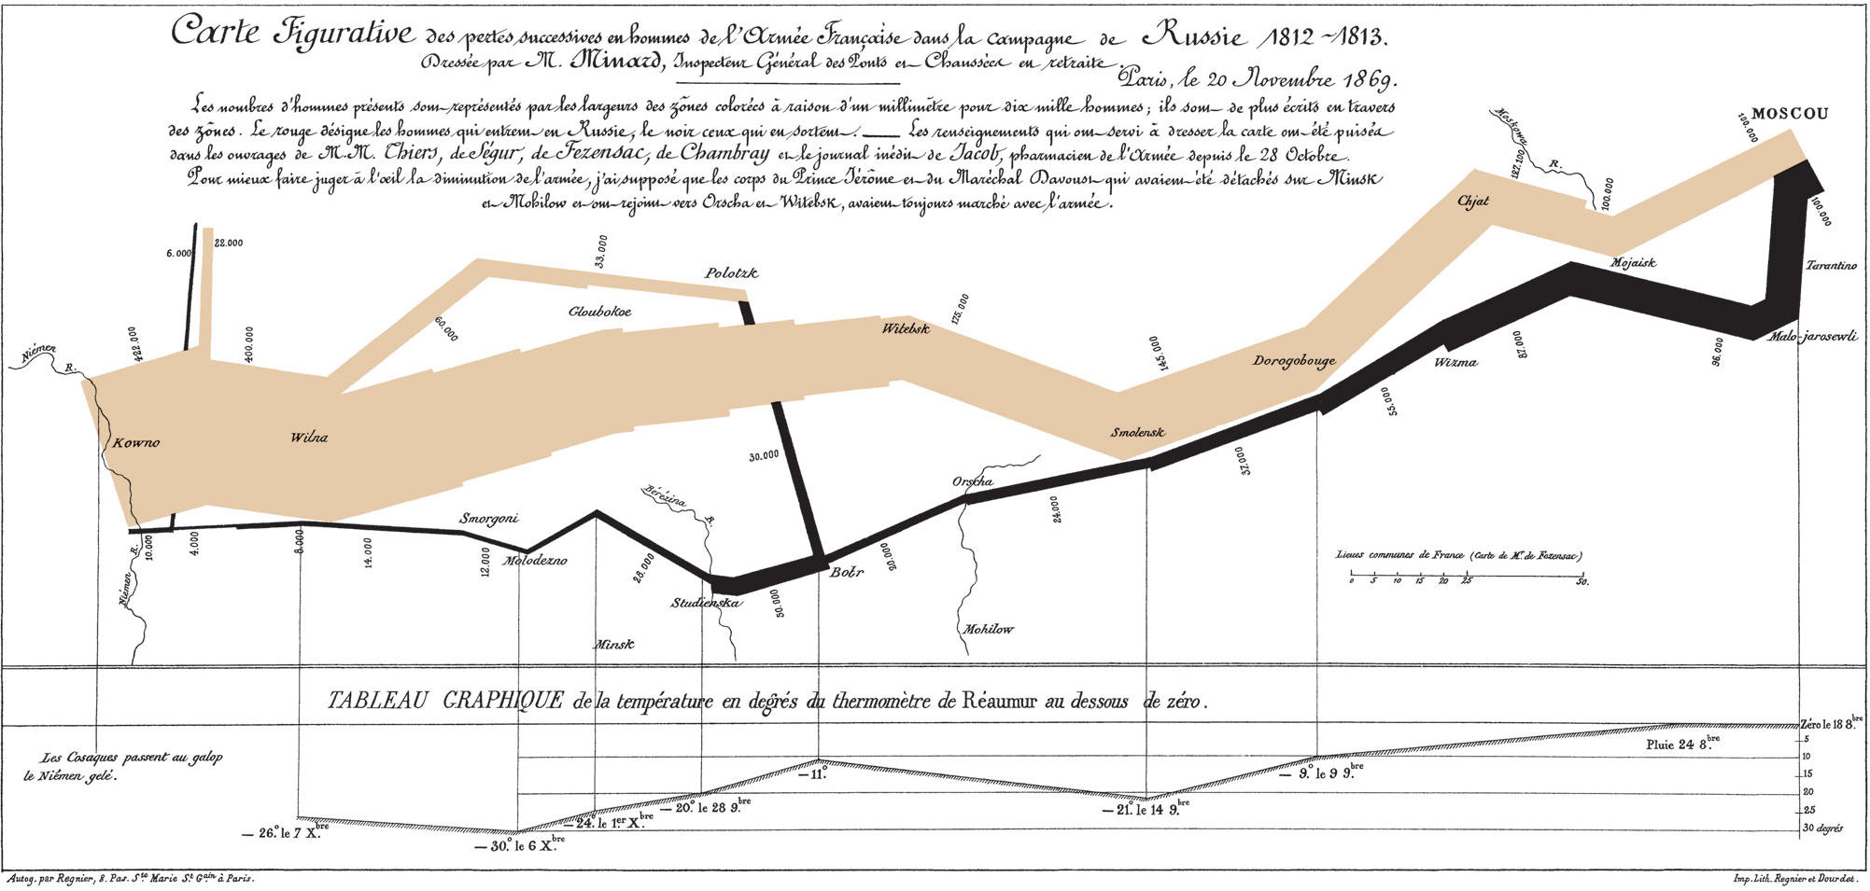
Figurative map of the successive losses in men of the French Army in the Russian Campaign 1812-1813 by Charles Minard, published in the Tableaux Graphiques et Cartes Figuratives de M. Minard, 1845-1869.
Notes:
Does anyone know what this is?
Edward Tufte calls this “Possibly the best statistical graph every done.” Before we discuss this, let’s take a minute to understand it. This is a visualization of Napoleon's Campaign into Russia created by Charles Minard. The size of the bar represents the number of troops during the invasion. The troops start off with 420,000. The light color shows the advance into Moscow and then the black line shows the retreat home. During the retreat, the temperature is plotted on the bottom of the chart on the Réaumur scale. Notice on the retreat that many troops are lost when they have to cross the rivers in the freezing temperatures.
---------------
Images used under the Wikipedia Creative Commons license. http://www.wikipedia.com

Slide 23
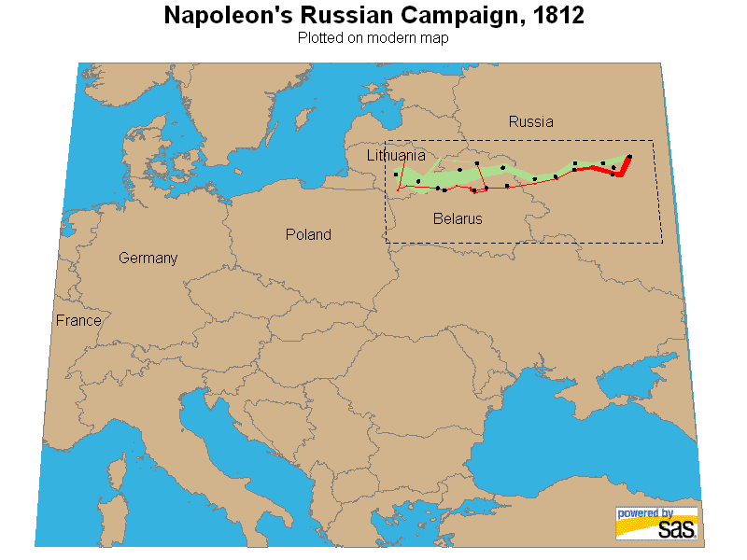
Notes:
The shape of the lines is based on the geographic movement of the troops. The distance scale on Minard’s map is shown in French Leagues (2.75 miles or 4,444 meters). The overall distance travelled covers from Lithuania to Moscow, which is 1,000 kilometers (over 600 miles). This would be like walking from Dallas, Texas to Nashville, Tennessee and back.

Slide 24
Notes:
This version was created in SAS showing an animation of the march.

Slide 25
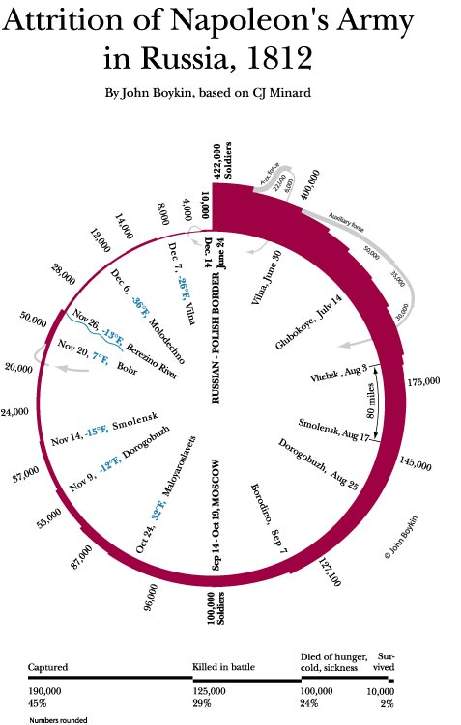
www.wayfind.com/napoleon.html
Notes:
Designers seem to like to make things in circular form which is what John Boykin did here. What interesting about this version is that it’s very easy to compare the start of 420,000 troops to 10,000 that return. Major cities and dates are plotted along with the temperature, but in addition, there are some overall statistics at the bottom of the chart that we now have. 190,000 captured, 125,000 killed in battle, 100,000 that died of cold and sickness.

Slide 26
Best Statistical Graph ever done?
Images used under the Wikipedia Creative Commons license. http://www.wikipedia.com
Notes:
[Class Discussion]
Who likes this graph or thinks this is the best statistical graph ever done? Why?
Anyone not like this? Why?

Slide 27
not everyone is a fan…
Images used under the Wikipedia Creative Commons license. http://www.wikipedia.com

Slide 28
On Minard’s graph: “This is one of the worse graphs ever made. [Tufte]'s very happy because it shows five different pieces of information on three axis and if you study it for fifteen minutes it really is worth a thousand words. I don't think that's what graphs are for. I think they try to make a point in two seconds for people who are too lazy to read the forty words underneath.”
Seth Godin
Best-selling author, Marketer and Public Speaker
Notes:
Marketing Guru Seth Godin thinks this is one of the worst graphs ever done. [read quote]

Slide 29
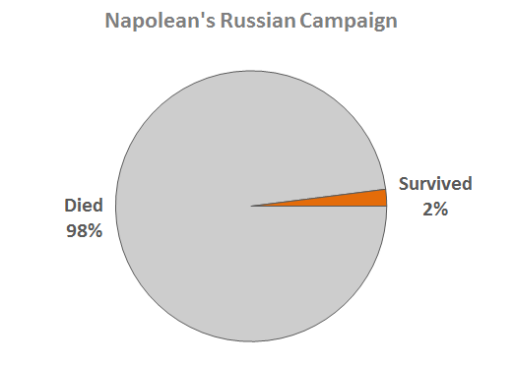
“Dumbing it down for the executive”
Recreation of Jorge Camoes Redesign (www.ExcelCharts.com)
Notes:
Seth would prefer to show the data like this, the executive view. “They’re all dead. We lost the war. Does anything else matter?”
NOTE:
This makes for a great class discussion. Some might argue that Seth is totally wrong, because he's made as assumption that graphs should make a point in 2 seconds. That's one way to use charts, but there's nothing wrong with dwelling on one. Others could argue that the originally is just too hard for most people to understand and in business or even for the general public, people won’t take the time necessary to read and understand those complexities.

